Slide 1
Heart Disease Detection.
By – Abdul Rauf Khan.

Slide 2
Introduction –
I have made a summary and a Machine Learning model based on how people get heart attack based on their day-to-day habits and routine.
And also because of some hereditary diseases it can lead upto cardiovascular diseases.
My model is based on prediction that is a person on verge of getting a heart attack or similar cardio vascular diseases by checking there medical history , what kind of lifestyle does one follow.

Slide 3
Objective
The final goal for this project is to get a better understanding due to which factors one can get cardio vascular diseases.
And one to convience to live a better life style.

Slide 4
Understanding our Variables .General_Health .Checkup .Exercise .Heart_Disease .Skin_Cancer .Other_Cancer .Depression .Diabetes .Arthritis .Sex .Age_Category .Height_(cm) .Weight_(kg) .BMI .Smoking_History .Alcohol_Consumption .Fruit_Consumption .Green_Vegetables_Consumption .FriedPotato_Consumption

Slide 5
Steps to Build a Machine Learning Model
-Understand the problem.
-Data Collection, Data Preprocessing & Exploratory Data Analysis.
-Split the data.
-Choose an appropriate model.
-Train the model.
-Prediction.
- Accuracy Check

Slide 6
Exploratory Data Analysis Exploratory Data Analysis (EDA), also known as Data Exploration, is a step in the Data Analysis Process, where a number of techniques are used to better understand the dataset being used.
The main purpose of EDA is to help look at data before making any assumptions. It can help identify obvious errors, as well as better understand patterns within the data, detect outliers or anomalous events, find interesting relations among the variables.
Exploratory Data Analysis (EDA) can be used to answer questions about standard deviations, categorical variables, and confidence intervals. After completing EDA and drawing insights, its features can then be used for more sophisticated data analysis or modeling, including machine learning.

Slide 7
Feature Engineering
Feature Creation
Transformations
Feature Extraction
Feature Selection

Slide 8
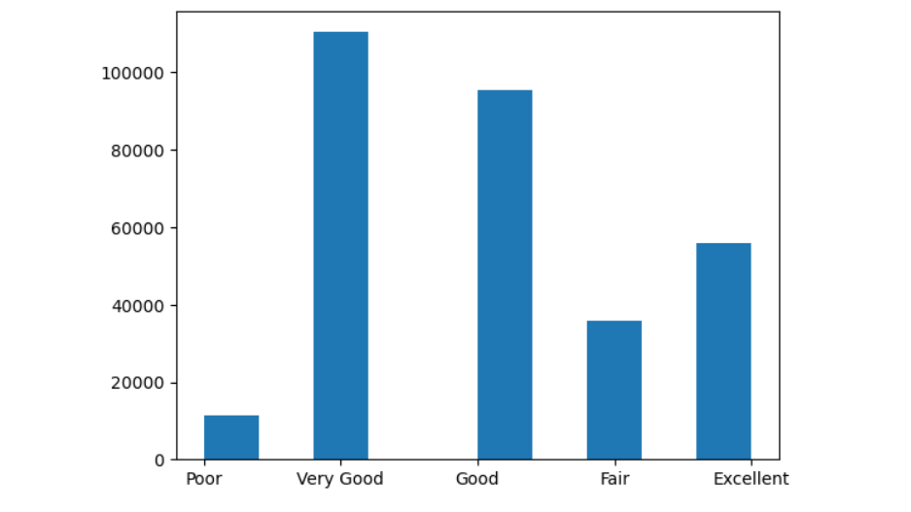
Some Insights of Data What are the general health of the people in the dataset ?
There are the general health of the people present in the dataset

Slide 9
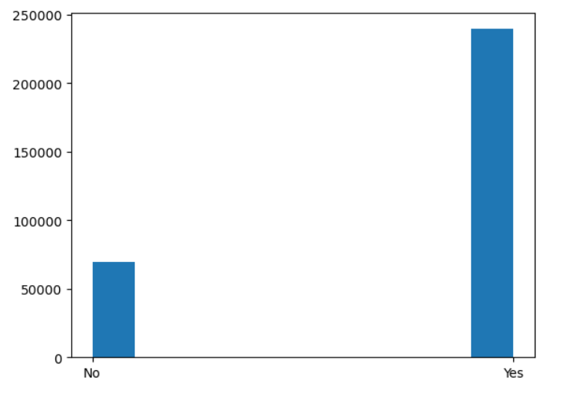
Some Insights of Data Data of People who do exercise ?
These graph is based on people who exercise regularly

Slide 10
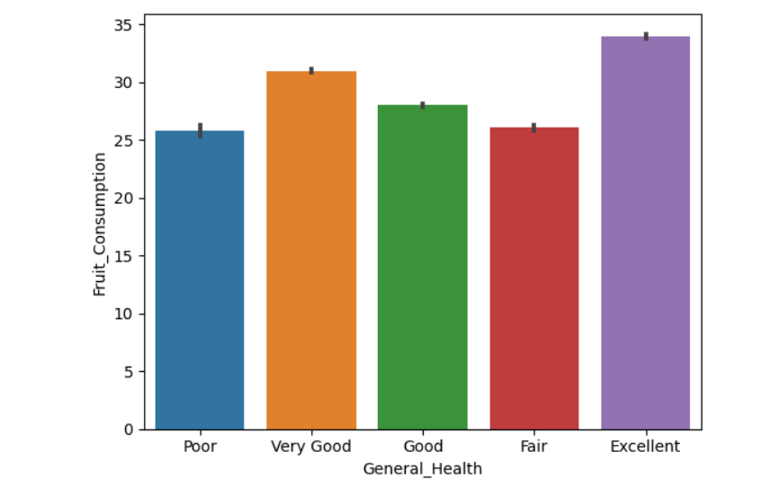
BAR plot of dataset
This comparison is regarding fruit consumption and general health.

Slide 11
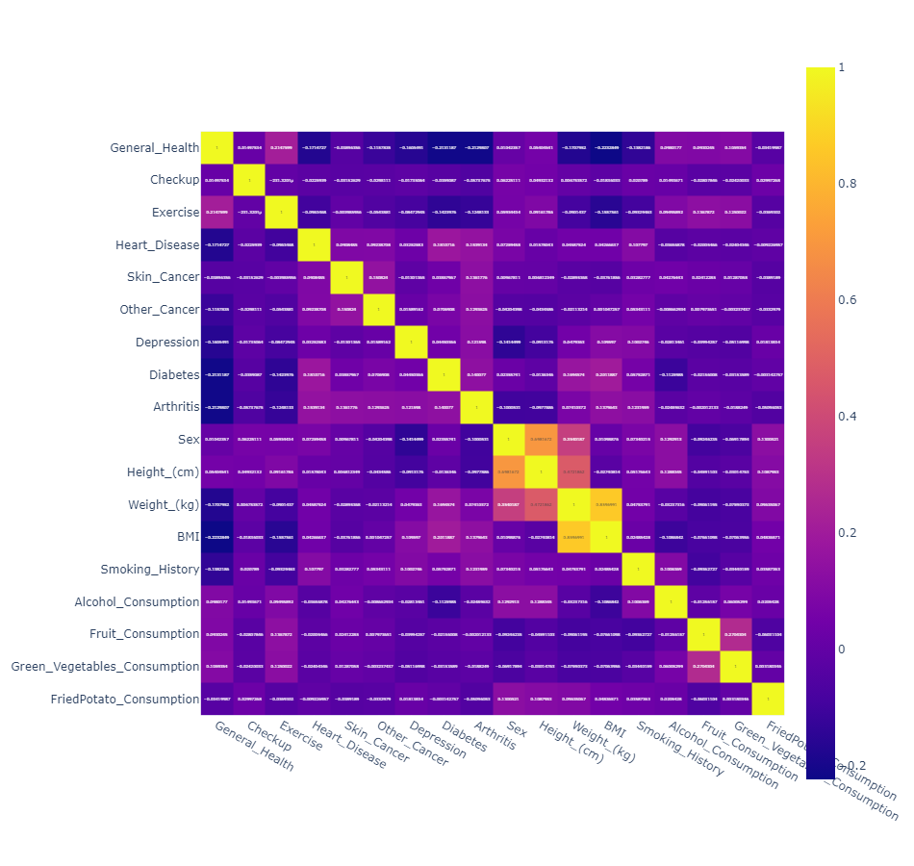
Pair plot for Dataset

Slide 12
Model Building
- Collecting Data
- Preparing the Data : Defining the Independent(X) and Dependent(Y) Variables
- After Defining , Splitting the data
- Choosing a Model
- Training the Model
- Evaluating the Model
- Making Predictions on the Test Data
- Check The Accuracy

Slide 13
Input Columns and Target Column
X = data[['Exercise','General_Health', 'Skin_Cancer', 'Other_Cancer','Depression', 'Diabetes', 'Arthritis','Sex','Height_(cm)','Weight_(kg)','BMI','Smoking_History','Alcohol_Consumption','Fruit_Consumption','Green_Vegetables_Consumption','FriedPotato_Consumption']]
Y = data['Heart_Disease']

Slide 14
Implementing Models Here are a few models which are applied to this Dataset
Models: Accuracy:
Logistics Regression 91.80%
Decision Tree 88.18%

Slide 15
Conclusion -Logistics Regression was Performed with an Accuracy of 91.88% on Testing Data. -By Predicting these values we can get an understanding due to which factors any person gets heart related disease.

